Slide 1
The Bloom Filter
Pravin Y Pawar

Slide 2
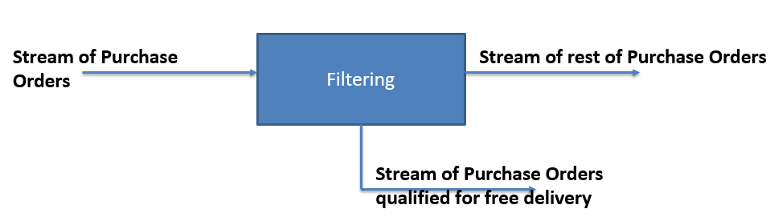
Filtering in a Stream
Refers to selection of elements in a stream

Slide 3
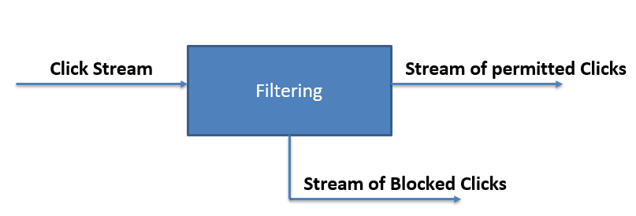
Filtering in a Stream
Refers to selection of elements in a stream

Slide 4
Exact Solution to Membership Problem
Assume that we want to keep track of which of a million possible items seen
Items labelled with ID number
Solution-1:
Keep an array of one million bits, initialized to all 0s.
Every time you see an item i, you just set the ith bit to 1.
Querying for item j is straightforward
The structure is very compact: 125KB will suffice if you pack the bits into memory.

Slide 5
Exact Solution to Membership Problem(2)
What if the size of the set is much larger / or not enumerable in practice?
names of customers, where the number of possible name strings is huge
All pair of IP’s communicating
Where does the solution takes you to?
Hash tables?
Use a hash function h to map from the space of inputs onto the range of indices for your table

Slide 6
Exact Solution to Membership Problem(3)
For an item i, set hash(i) bit to 1
What if for distinct i,j, hash (i) = hash(j)?
Use collision resolution techniques
Let us assume that you do not want to use those extra storage, or complicate the mechanism to resolve collisions
That is, no additional storage. Just the bit hash(i) must be relevant bit
Hard to handle collision
What if we use more hash functions in place of one?

Slide 7
Exact Solution to Membership Problem(4)
A compact data structure that summarizes a set of items
Dictionary answering membership questions
“ Is an item x stored in the structure or not? “
Answers the membership question approximately, with lesser storage
“the item has definitely not been stored” or “the item has probably been stored.”
Listing of items in the dictionary is not possible

Slide 8
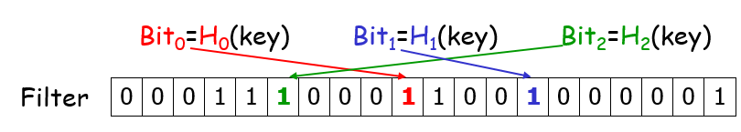
Blooms Filters
Bloom filter: A bit vector that represents a set of keys
A key is hashed d (e.g. d=3) times and represented by d bits
Construct: for every key in the set, set its 3 bits in vector
Membership Test: given a key, check if all its 3 bits are 1
Definitely not in the set if some bits are 0
May have false positives

Slide 9
Bloom filters (2)
Can very quickly answer variations on the Yes/No question
“is this item in the set?”, like “have I seen this item before?”
Has constant time complexity for both
adding items
asking whether they are present
Requires very little space relative to the size of the items you need to store and check

Slide 10
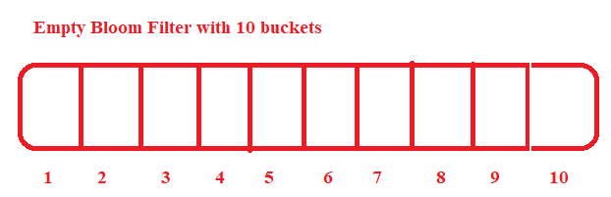
Bloom Filter with example
Step 0
Think of a Bloom filter as a large set of numbered buckets, each one starting off empty.
Imagine we want to keep track of the books that I own.
To do this, lets use a Bloom filter with 10 buckets and three hash functions.

Slide 11
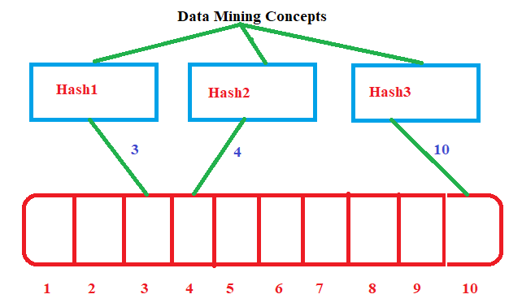
Bloom Filter with example (2)
Step 1 - Initialization
Lets start by putting "Data Mining Concepts" into our Bloom filter
Internally, the filter takes book name and passes it to the three hash functions, which return three identifiers.
In this case, "Data Mining Concepts" hashes to identifiers 3, 4, and 10.
The filter goes and fills up every bucket whose number matches one of the identifiers — 3, 4, and 10.
It’s able to do this very quickly because it can jump straight to each bucket to fill it up, just like you jump straight to page numbers from an index.

Slide 12
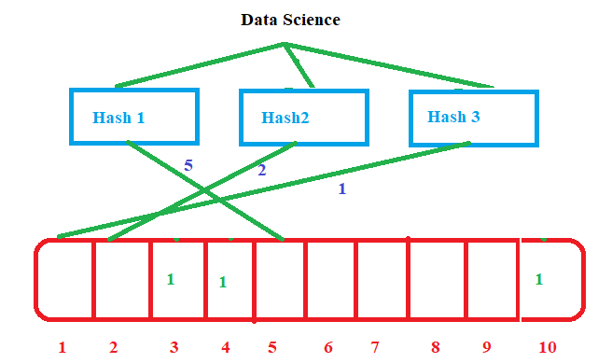
Bloom Filter with example (3)
Step 2 - Addition
Next we put "Data Science" into our filter.
Using the same hash functions, "Data Science" hashes to 5, 2, and 1, so those buckets get filled up too.
After we’ve done both of these operations, buckets 1, 2, 3, 4, 5, and 10 are full.

Slide 13
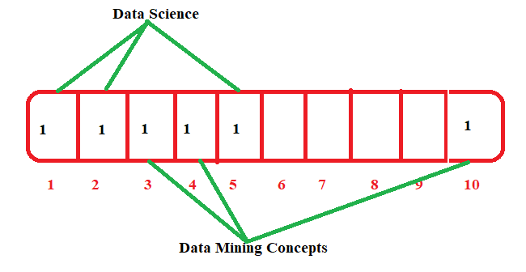
Bloom Filter with example (3)
Step 3 – Querying
Lets ask filter whether “Data Mining Concepts” is present or not?
Book name will go through same three hash function
Hash will result into three values i.e. 3, 4 and 10
Go to positions 3, 4 and 10, if all bits are set to 1, means book is already in the filter

Slide 14
Bloom Filter with example (3)
Step 4 - Querying
Lets ask filter whether “Streaming Data” is present or not?
Book name will go through same three hash function
Lets say hash will result into three values i.e. 3, 4 and 7
Go to positions 3, 4 and 7 , not all bits are set to 1, hence book is not seen earlier.

Slide 15
Bloom Filter with example (3)
Step 5 - False Positives
Lets check book “Data Mining” is present or not
Book name will go through same three hash function
Lets say hash will result into three values i.e. 3, 4 and 10
Now check positions related to 3, 4, and 10, all bits are set to 1 , means books is known one
But actually filter never has seen that book

Slide 16
Thank You!
In our next session: Distinct Value Sketches

